Slide 1
D2D Beginner Tableau Training
January 10th and January 11th
presented by Walter Mehra
D2D Team Member

Slide 2
Pre-Class Activities
Please make sure you do the following prior to the training session:
Ensure that Tableau Desktop (version 9.3) or higher (D2D is on 10.3.4) is installed on your computer and you have a valid license (or are on Tableau granted two-week trial license);
Review the Basic Data Concepts document
Download the dataset used for this training to your computer’s desktop

Slide 3
Objectives
Tableau UI (User Interface)
Loading and Joining Data
Creating Analytics and Dashboards

Slide 4

Data Analytics and Visualization Steps (CRISP-DM)
Business Understanding of the project objectives and requirements from a business perspective
Data Understanding phase starts with initial data collection and proceeds with activities that enable you to become familiar with the data, identify data quality problems, discover first insights into the data, etc.
Data Preparation phase covers all activities needed to construct the final dataset including tasks such as table, record, and attribute selection, as well as transformation and cleaning of data
Modeling phase covers the build out of analytics, whether descriptive, predictive, or prescriptive
Evaluation phase requires thorough evaluation and review, to be certain the analysis properly achieves the business objectives. A key objective is to determine if there is some important business issue that has not been sufficiently considered. At the end of this phase, a decision on the use of the data mining results should be reached.
Deployment can vary based on the requirements, the deployment phase can be as simple as generating a report or as complex as implementing a repeatable data mining process across the enterprise
Retrieved from: https://en.wikipedia.org/wiki/Cross_Industry_Standard_Process_for_Data_Mining#/media/File:CRISP-DM_Process_Diagram.png

Slide 5
Type of Analytics
According to Gartner Research:
Descriptive Analytics - is the examination of data or content, usually manually performed, to answer the question “What happened?” (or What is happening?), characterized by traditional business intelligence (BI) and visualizations such as pie charts, bar charts, line graphs, tables, or generated narratives.
Predictive Analytics - advanced analytics which examines data or content to answer the question “What is going to happen?” or more precisely, “What is likely to happen?”, and is characterized by techniques such as regression analysis, forecasting, multivariate statistics, pattern matching, predictive modeling, and forecasting.
Prescriptive Analytics - advanced analytics which examines data or content to answer the question “What should be done?” or “What can we do to make _______ happen?”, and is characterized by techniques such as graph analysis, simulation, complex event processing, neural networks, recommendation engines, heuristics, and machine learning.
http://www.gartner.com/it-glossary/

Slide 6
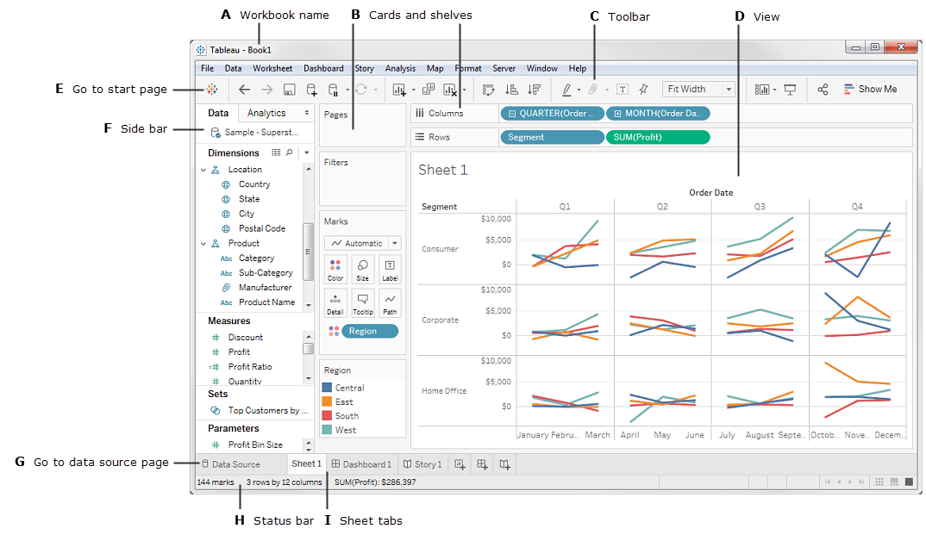
The Tableau Workspace
Workbooks and Sheets name. For more details on workbooks and sheets.
Shelves and Cards - Drag fields to the cards and shelves in the workspace to add data to your view.
Toolbar - Use the toolbar to access commands and analysis and navigation tools.
Parts of the View - This is the workspace where you create your data visualizations.
Goes to the start page. For more information, see Start Page.
The Side Bar - The side bar provides two panes: the Data pane and the Analytics pane. For more information, see The Side Bar.
Go to the data source page. For more information, see Data Source Page.
Status Bar - Displays information about the current view.
Sheet tabs - Tabs represent each sheet in your workbook. This can include worksheets, dashboards and stories. For more information, see Sheets.
For Reference: The Tableau Workspace

Slide 7
Tableau Terminology
Tableau Files - there are six type of files that Tableau creates:
.twb - Tableau Workbook (does not include/package the data with the workbook)
.twbx - Packaged Tableau Workbook which contains data and can contain external files such as images, etc.; think of it as a zip file full of everything you need to visualize the data
There are four other Tableau file, you can read about them on Tableau’s website: http://onlinehelp.tableau.com/current/pro/online/mac/en-us/environ_filesandfolders.html
Sheets are part of Tableau Workbooks, there are three types: Worksheet, Dashboard, and Story

Slide 8
Data Terminology
Data Type | Descriptions/Details | Examples
Number (Decimal) or Number (Whole) | These are either integers or floating points. If a variable can take on any value between two specified values, it is called a continuous variable; otherwise, it is called a discrete variable | 3 or 3.14159265359 (Continuous)
Date or Date and Time | Tableau recognizes dates in almost all formats, these values are typically used for time series or trend analysis | 11/28/2017 or 11/28/2017 1:00 PM
Boolean | They are logical values | True or False
String | Any sequence of characters. They are enclosed within single quotes. The quote itself can be included in a string by writing it twice. | GSA, Budget Activity, Lease, NAICS
Geographic Role | Not a datatype, but does clarify the desired outcome for the data field Identifier for Tableau to facilitate map building included roles are Airport, Area Code, CBSA/MSA, City, Congressional District, Country / Region, County, Latitude, Longitude, NUTS Europe, State/Province, Zip Code/Postcode | KIAD (Airport), 202 (Area Code), VA (State/Province), etc.
Tableau will categorize your data fields into one of two buckets:
Dimension is something you categorize with (e.g., color of a shirt)
Measure is something you do math with (e.g., the number of white shirts)

Slide 9
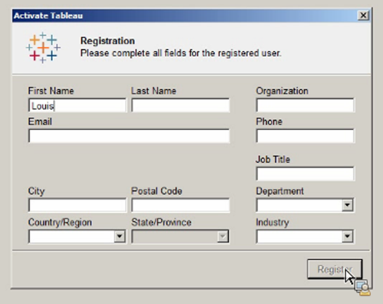
Tableau Desktop Version & Registration
Check that Tableau Desktop is installed on your workstation. Version should ideally be the current GSA version, 10.3.4.
Ensure Tableau Desktop is registered in one of two ways.
New users: open the software and register for the free 2-week trial.
Current users: no action needed; you should already have a registered version of the software.

Slide 10
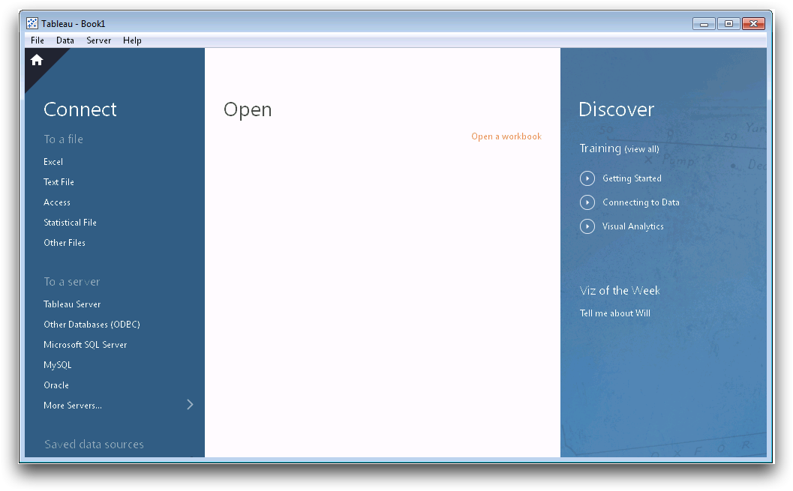
Using Tableau (Data Sources)
Dataset(s): REXUS Building Data
Question: What are each of the three panes on the Tableau Desktop home page used for?
Steps:
Open Tableau
Browse the different sections of the Start Page:
Connect
Open
Discover
Connect to our data source, Excel
Using the Discover pane on the Tableau Desktop home page is a great resource to find assistance for the various Tableau capabilities and sample dashboards
The Connect and Open pane are the primary panes to work from, one will provide you the ability to connect to new data sources while the other will enable you to open workbooks you’ve recently worked on

Slide 11
Using Tableau (Data Sources cont’d)
Dataset(s): REXUS Building Data
Question: What are each of the three panes on the Tableau Desktop home page used for?
Steps:
Drag sheet datagovbldgrexus to the window
Select connection type of Extract
Additional updates to the data include:
Adding filters
Adding additional data to join
Review other options, such as number of records to display, changing data types, etc.
Click on Sheet 1 to begin analysis
Data Source Page provides tools to change data and metadata:
Joins
Changing field names
Changing data types
Filters
Extract vs Live Connection:
Extract will generally be faster but not provide a real-time connection Live will provide a real-time connection to your data but may be limited by performance or features
Using your Tableau Repository or Tableau Server, multiple workbooks can connect to the same Tableau data source

Slide 12
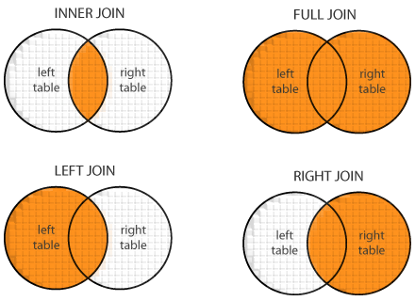
Data Joining vs Data Blending
Data Join
Data Blend
Only join data within the same database (fixed in Tableau 10.0 as a cross-database join)
More flexibility in joining data, you can easily identify a left, right, inner, and full joins
Join is done once at the data source and used for every everything while a blend is specific
Join data across databases (for versions below 10.0)
When you use data blending to combine data, a query is sent to the database for each data source that is used on the sheet.
Always mimics a left join, emulation of other types of joins is possible but a bit more work:
Primary/Driver data source (left-side of join) is defined by the first variable in a dataset dragged into the worksheet:
SELECT a.ID, a. Name, a.Height, b.Weight
FROM Table_A a
LEFT JOIN Table_B b ON Table_A.ID = Table_B.ID;
http://www.dofactory.com/sql/join

Slide 13
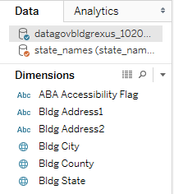
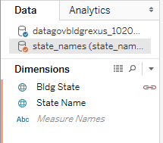
Data Blending
Dataset(s): REXUS Building Data, State Names
Question: How many records are there per state?
Steps:
Open the REXUS data and drag sheet datagovbldgrexus to the window
Rename Sheet 1 to Blend
Add a New Data Source; import the State Names dataset and switch back to the Blend worksheet
Drag Bldg State from the REXUS dataset to the rows shelf and Number of Records to columns shelf
Switch to the State Names dataset and drag State Names from the State Names dataset to the filter shelf, filter the results to only include California, Texas, Florida, and New York
Joins vs. Blends
Joins are more efficient when data is in the same database and when there is high-cardinality (lots of unique numbers)] in the joining fields
Blends are useful when there is a one-to-many relationship in the data and you want to summarize it more efficiently (inclusion of * for the one-to-many relationship to show multiple values), also known as granularity of the data
Joins occur once while blends call the database each time you make a change to your worksheet
Primary vs. Secondary Datasources
Primary datasource (left-side of join) is defined by the first variable in a dataset dragged into the worksheet
Tableau auto selects the relationship between datasources when they have similar names
Data → Edit Relationships to define or edit relationships

Slide 14
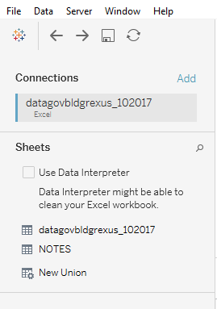
Cross-Database Joins
Dataset(s): REXUS Building Data, State Names
Question: How many records are there per state?
Steps:
Open up Tableau Desktop 10 (if you don’t have it, just follow along)
Create a new connection for our first dataset (REXUS)
Click on Add, then let’s connect to the second dataset (State Names)
Sheet1 from the State Names should have automatically populated and joined to our first dataset, if not, drag it into the canvas
Review the data for a left, right, inner, and outer join
Joins vs. Blends
Joins are more efficient when data is in the same database and when there is high-cardinality (lots of unique numbers)] in the joining fields
Blends are useful when there is a one-to-many relationship in the data and you want to summarize it more efficiently (inclusion of * for the one-to-many relationship to show multiple values), also known as granularity of the data
Joins occur once while blends call the database each time you make a change to your worksheet
Primary vs. Secondary Datasources
Primary datasource (left-side of join) is defined by the first variable in a dataset dragged into the worksheet
Tableau auto selects the relationship between datasources when they have similar names
Data → Edit Relationships to define or edit relationships

Slide 15
Shaping Your Data for Tableau
Normalize your data into the First Normal Form (1NF)
Remove redundant columns (e.g., Year)
Remove titles from your data tables if you’re using Excel or Google Sheets
Every column is a data field/variable, so if you want to create a filter on Year, it should all be in one column
Don’t include Totals from your source data, let Tableau generate your totals
Shape Your Data in Columns
Agency | Year | Value
GSA | 2016 | 103
GSA | 2017 | 50
GSA | 2018 | 125
Dept. of Interior | 2016 | 88
Dept. of Interior | 2017 | 100
Dept. of Interior | 2018 | 75
Crosstabs Not Ideal for Tableau
Agency | 2016 | 2017 | 2018
GSA | 103 | 50 | 125
Dept. of Interior | 88 | 100 | 75

Slide 16

End of Part 1
Any questions?
Anything you’d like covered for next time?
Notes:
Image Source: http://www.gsa.gov/portal/category/100000. Visited 12/7/15.

Slide 17
Analysis – Data Exploration (Exercise 1)
Dataset(s): REXUS Building Data
Question: What are the differences between Tableau Field Types (Continuous and Discrete Dimensions and Measures)?
Steps:
Create a new Tableau workbook and import in the REXUS dataset
Rename the worksheet Field Types
Right click on the Region Code dimension and select Describe…
In the Describe Field box, click on Load to load the set of valid values (only first 20, if more than 20) for the field, review results and exit
Drag Region Code dimension to the rows shelf
Drag the Bldg ANSI Usable to the columns shelf
In the columns shelf, right click on Region Code and change the field type to Continuous
In the columns shelf, right click on Region Code and change the field type to Measure and calculation to Count (Distinct)
Change the aggregation to Count, Sum, Average
Change the field type to a Discrete from Continuous
Dimensions contain qualitative values (such as names, dates, or geographical data).
Measures contain numeric, quantitative values that you can measure. You can apply calculations to them and aggregate them.
When a measure or dimension is green, it is continuous. Its values are treated as an infinite range. Generally, continuous fields add axes to the view.
When a measure or dimension is blue, it is discrete. Its values are treated as finite. Generally, discrete fields add headers to the view.
Worth noting how each field type affects the visualization in a view and the graph options (i.e., Show Me)

Slide 18
Analysis - Summarize (Exercise 2)
Dataset(s): REXUS Building Data
Question: What are the number of properties per State?
Steps:
Create a new worksheet, title it Summary
Drag Bldg State field to the rows shelf
Drag the Number of Records field to the columns shelf
Click on Show Me to change your visualization from a bar graph to a crosstab
There are two data roles in Tableau:
Dimension are for categorizing
Measure are for calculations
Know the Tableau-generated fields, including:
Measure Names
Measure Values
Number of Records
Use “Show Me” to change the graph type
Three ways to create a view:
Click & drag a field
Double-click a field
Highlight field(s) then click “show me” to see Tableau’s “best guess” graphs

Slide 19
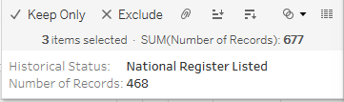
Analysis - Grouping (Exercise 3a)
Dataset(s): REXUS Building Data
Question: What percent of GSA’s owned building inventory is historic? Steps:
Create a new worksheet, title it Historical Status
Drag Historical Status to the columns shelf
Drag Number of Records to the row shelf
Create a table calculation on Number of Records by right-clicking on the Number of Records, selecting Quick Table Calculation then select Percent of Total
In the graph, multi-select (drag across the categories or use the control key on your keyboard and select each one at a time):
National Historic Landmark
National Register Listed
National Register Eligible
Hover over the selected group until the tool tip appears with multiple options, select the paper clip icon (Group)
From the marks card, drag the newly created grouped field (Historical Status (group)) and replace the Historical Status pill in the rows shelf (hold the control key on your keyboard to copy the grouped field as-is)
Drag the Number of Records field from the columns shelf to the label control on the marks card
Creating groups is one way to combine multiple responses into one and enable aggregation that isn’t readily available in the underlying data
Marks tooltip:

Slide 20
Analysis - Grouping (Exercise 3b)
Dataset(s): REXUS Building Data
Question: How many buildings are there per Region?
Steps:
Create a new worksheet, name it Regions
Drag Bldg State to the view, a geographic map should auto-populate, click on Show Me and change it to a filled map
Drag Region Code into the labels marks control
Select each region and group them (by Bldg State) using the marks tool tip (see guidance in Exercise 3a example)
Drag Number of Records to the color marks control card
Remove Bldg State from the details marks control card
Creating groups is one way to combine multiple responses into one and enable aggregation that isn’t readily available in the underlying data

Slide 21
Analysis – 508 Compliance (Exercise 4)
Dataset(s): REXUS Building Data
Question: What tools can we leverage for 508 Compliance in Tableau?
Steps:
Navigate back to the Historical Status tab
Add title
E.g., descriptive title “Percent of Historical Buildings”
E.g., question you’d like viewers to ask, such as “Does historic status vary among leased versus owned properties?”
Rename y-axis % of Properties
Drag Bldg State to the Filter Shelf
Enable Quick filters
Change view fit from Normal to Entire View
Change color scheme to Color Blind 10
Display and review the Summary Card
Display and review the Caption Card
Review how to enhance dashboards with Tool Tips
The filter shelf controls all view-based filter functionality
The only other filters in Tableau are those within the data import process.
Different types of filters are available for different data types
The ColorBrewer site is another resource for identifying an optimal color palette that is color blind safe

Slide 22
Analysis – Viz Controls (Exercise 5)
Dataset(s): REXUS Building Data
Question: Which states contain more historic properties than others?
Steps:
Double-click Bldg State
Drag Historical Status (group) to the color control
Drag Number of Records to the Size control and into the view
Change marks type from Automatic to Pie (you may want to change the color of the pie)
Focus map on United States (continental). To do this, create Set “Lower 48 + DC” that excludes 7 areas: AK, AS, GU, HI, MP, PR, and VI. Drag to filter shelf.
Drag Bldg State to the filter box then right-click on the pill in the filter box and select Show Filter
Increase the size of the Pie marks
Edit pie legend to read Number of Properties
Give the worksheet a title Historical Properties by State
Sketch your visualization before you start creating it or risk aimlessness
Use your variables correctly, remember from earlier:
Dimension are for categorizing
Measure are for calculations
You can use the search box on your map to zoom into specific locations:
Continent
Country
State or province
County
City
Postcode

Slide 23
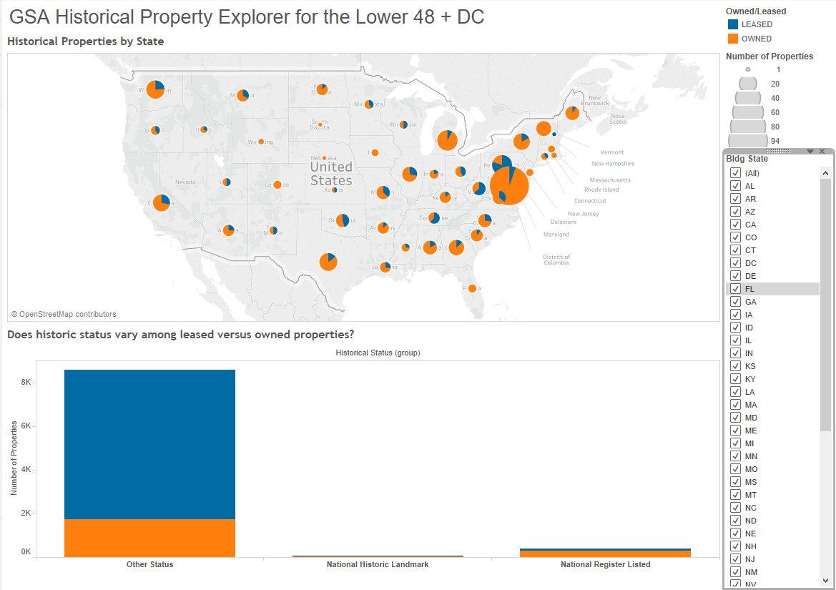
Exercise 6 – Creating a Dashboard

Slide 24
Dashboard (Exercise 6)
Dataset(s): REXUS Building Data
Question: Which states contain more historic properties than others?
Steps:
Create a new sheet, select Dashboard
Add a Vertical Container
Drag in a Text Box for a title
Write title in text box “GSA Historical Property Explorer for the Lower 48 + DC”
Drag “Exercise #4” sheet below Text Box
Drag “Exercise #2” sheet below “Exercise #4” sheet
Apply the “State” filter to “All Worksheets using this Data Source”
Use vertical and horizontal containers to better arrange your objects.

Slide 25
Dashboard - Notes (Exercise 7)
Dataset(s): REXUS Building Data
Question: None
Steps:
Create a new dashboard tab called “Notes.”
Write necessary documentation to do the following:
interpret the dashboard
identify source systems
reproduce the calculations
Do not go overboard! Think of the notes tab as a map rather than an encyclopedia.
Pithy > Wordy
Sufficient > 100% Comprehensive

Slide 26
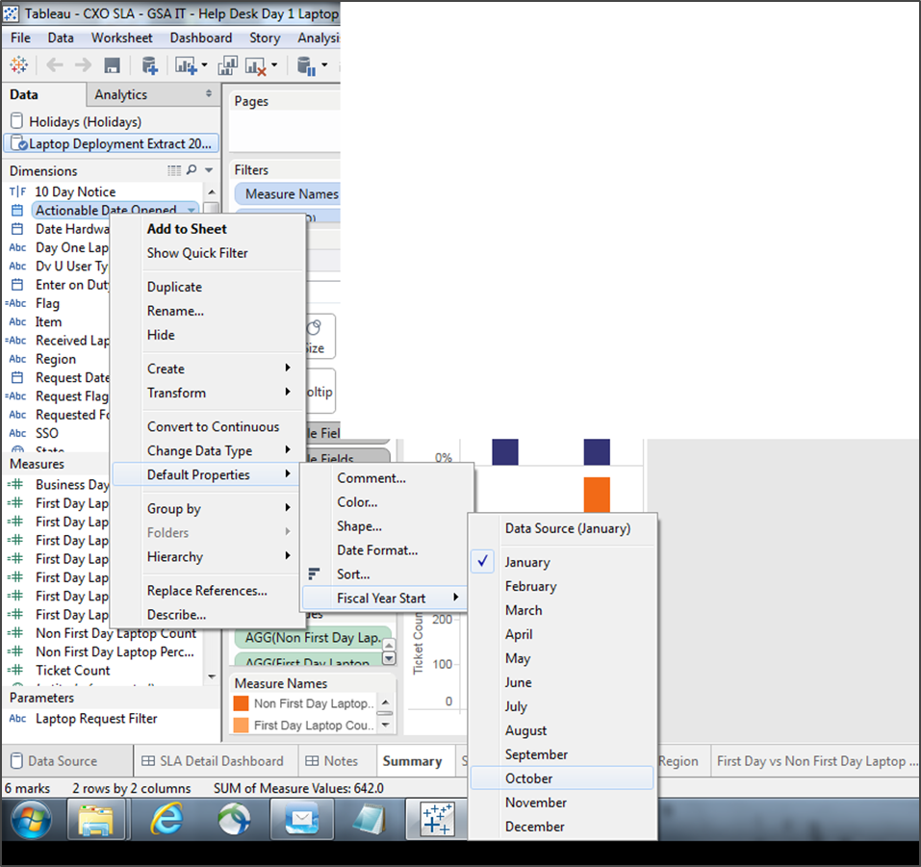
Fiscal Year Start
Right-click on a date field
Hover until you get to Fiscal Year Start > Month. Choose desired month, e.g. October.

Slide 27
Tableau Official & Unofficial Resources
Official Tableau Resources
Online Help: http://onlinehelp.tableau.com/v9.0/pro/online/windows/en-us/help.htm
Quick Start Guide: http://onlinehelp.tableau.com/v9.0/pro/online/windows/en-us/help.htm
Training, videos, webinars, white papers, events: http://www.tableau.com/learn
Tableau Keyboard Shortcuts - http://onlinehelp.tableau.com/current/pro/desktop/en-us/shortcut.html
Tableau User Groups -- these exist across the country (for Washington, DC go to http://community.tableau.com/groups/washington-dc)
Tableau Public Gallery, lots of interesting-looking examples: https://public.tableau.com/s/gallery
Whitepaper “Designing Efficient Workbooks.” http://www.tableau.com/learn/whitepapers/designing-efficient-workbooks
Unofficial Tableau-related Sites
http://www.dataplusscience.com/TableauReferenceGuide/
http://vizpainter.com/
http://drawingwithnumbers.artisart.org/
https://3danim8.wordpress.com/

Slide 28


